Slide 1
APIs
http://en.wikipedia.org/wiki/Web_services

Slide 2
There Are Many APIs
There are organizations that put up public APIs and sell access to those APIs
We will explore a geocoding API based on the OpenStreetMap data
You need an account to access this API
There is a free level of requests
You pay above that rate of usage
https://www.geoapify.com/

Slide 3
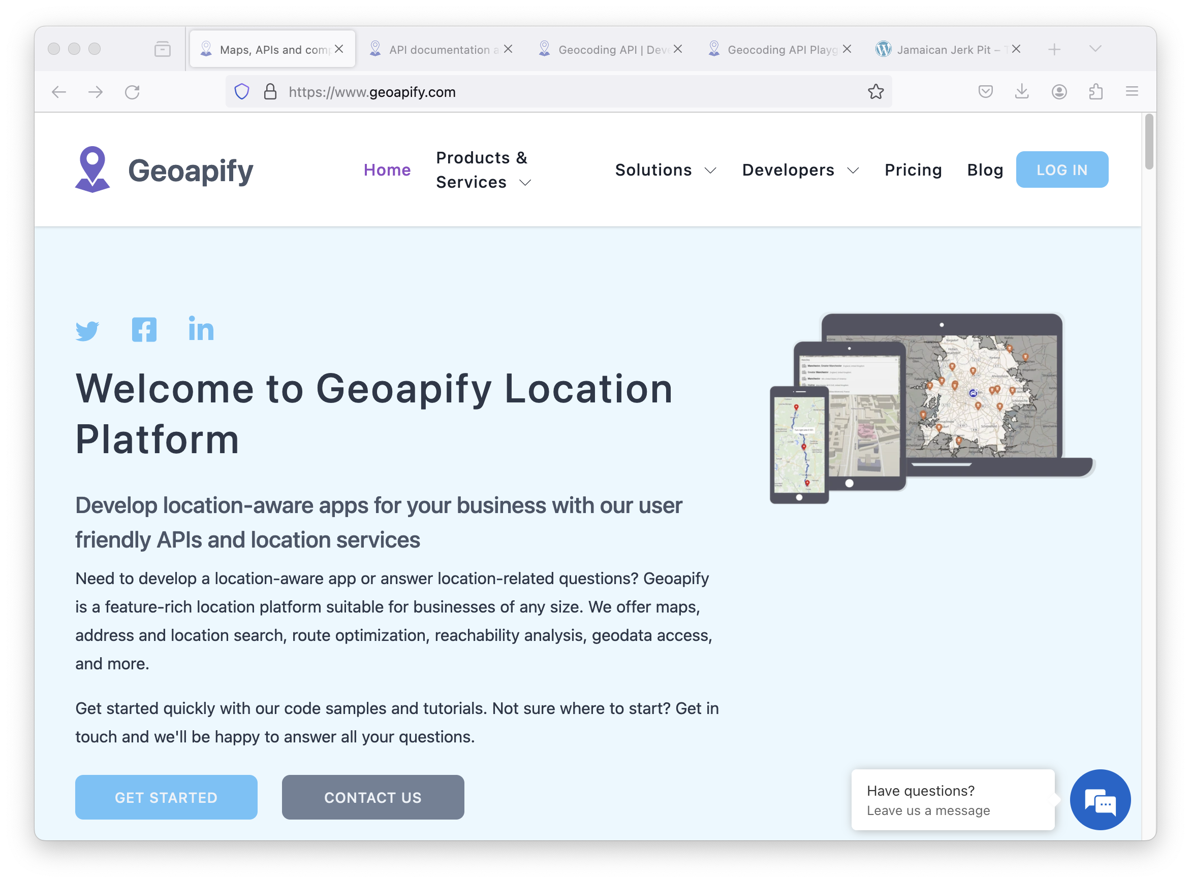
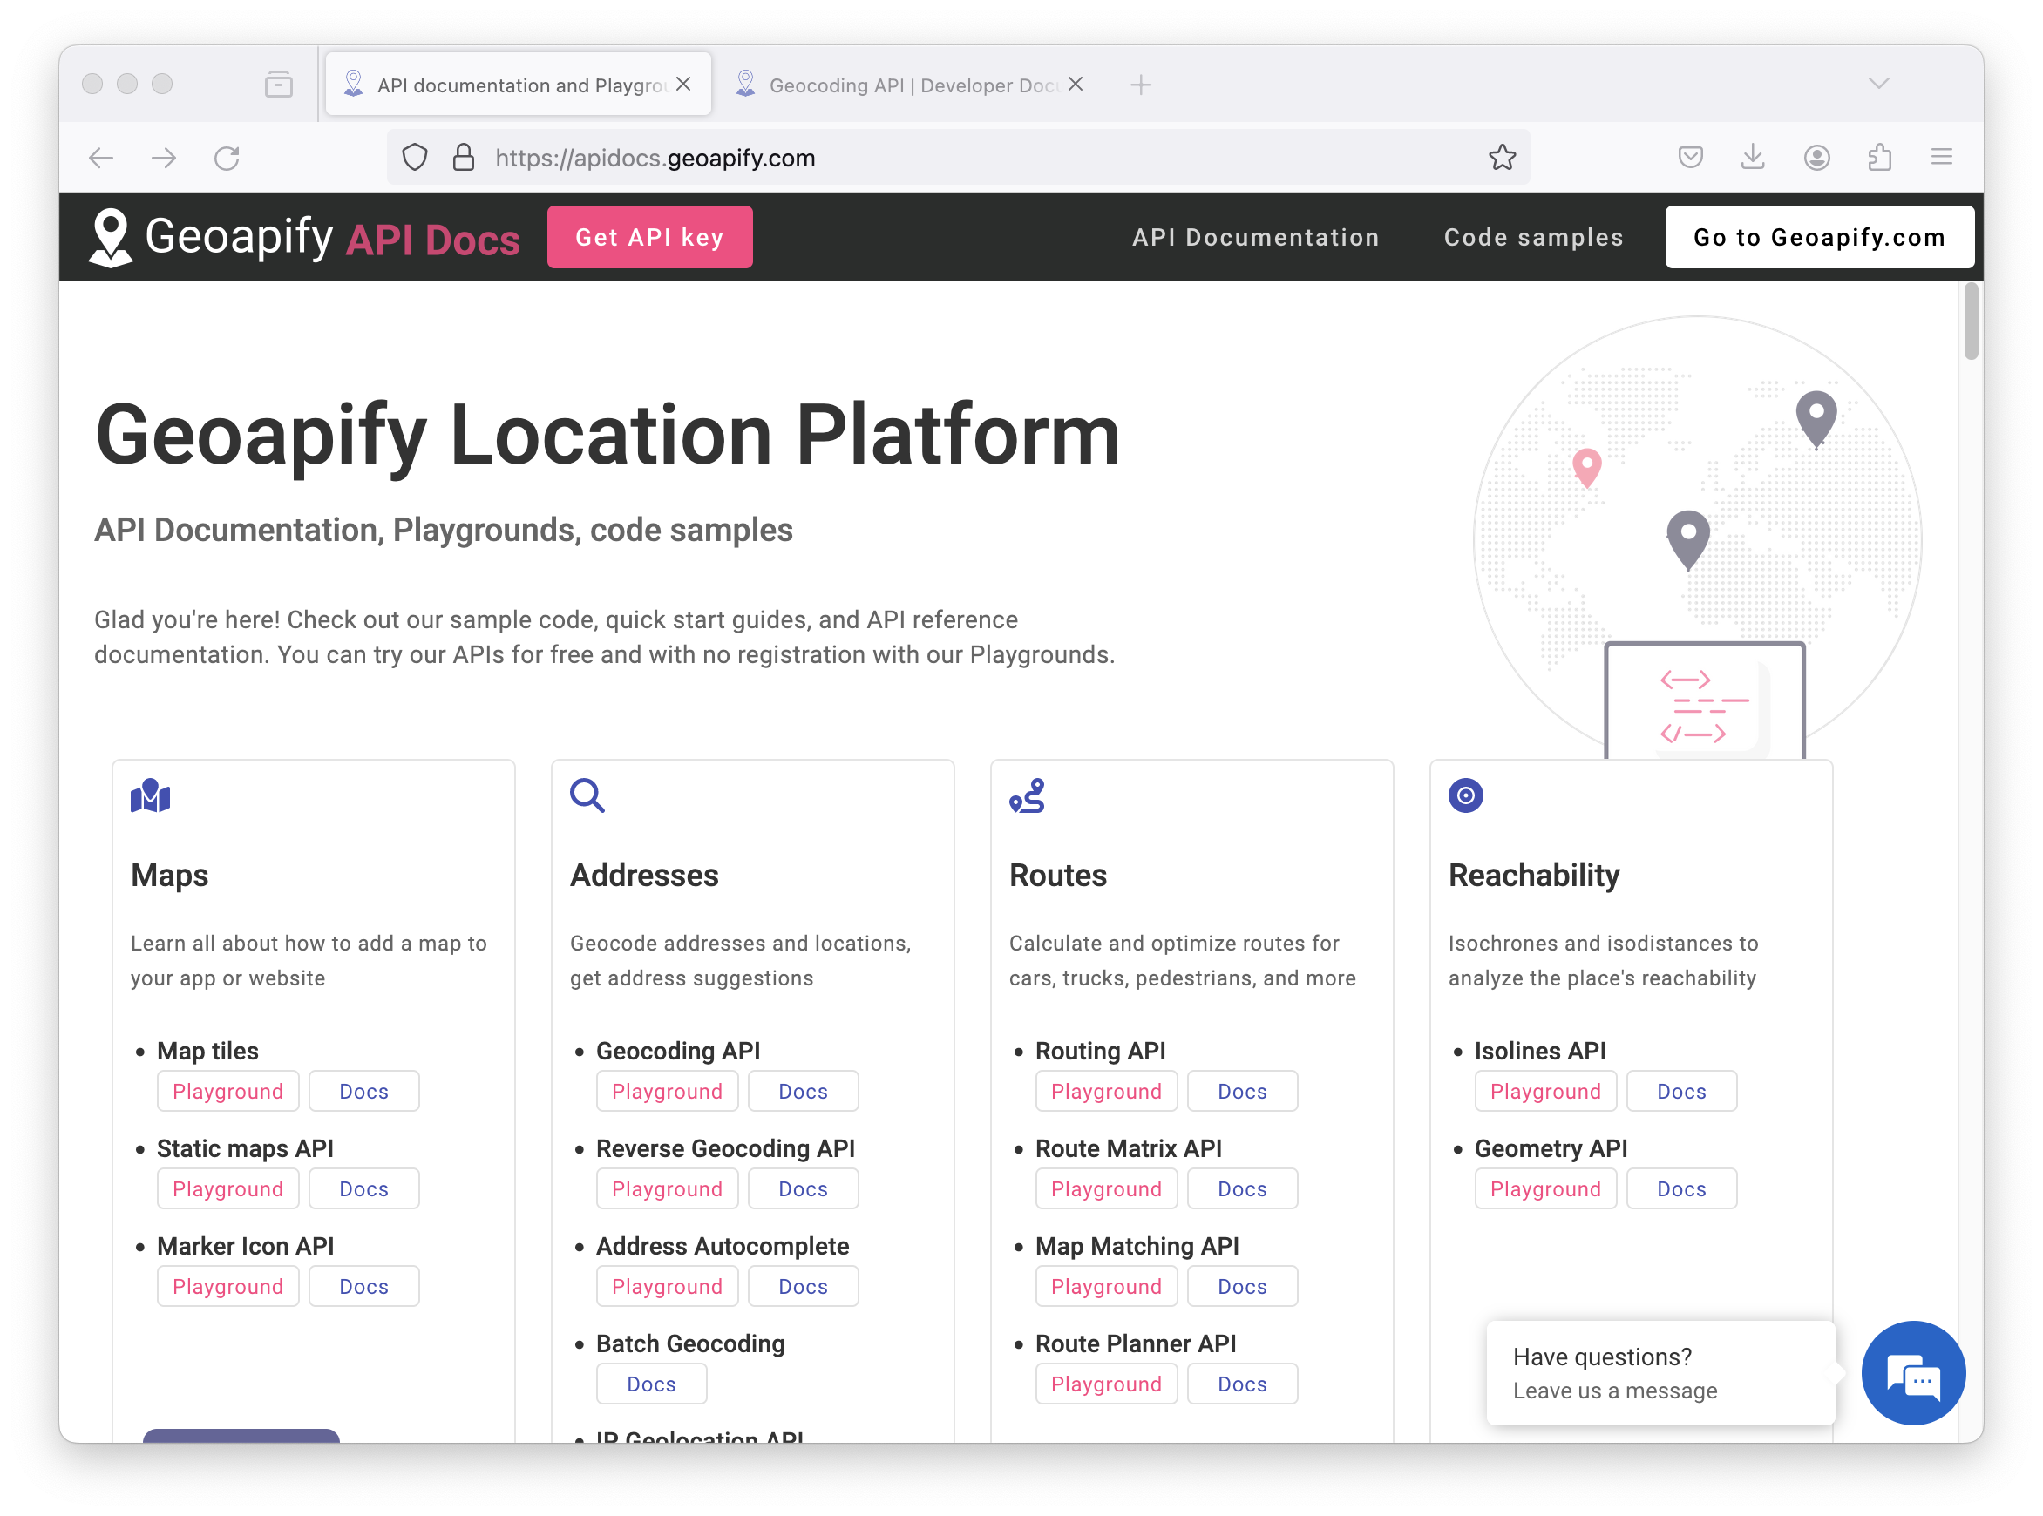
https://www.geoapify.com/

Slide 4
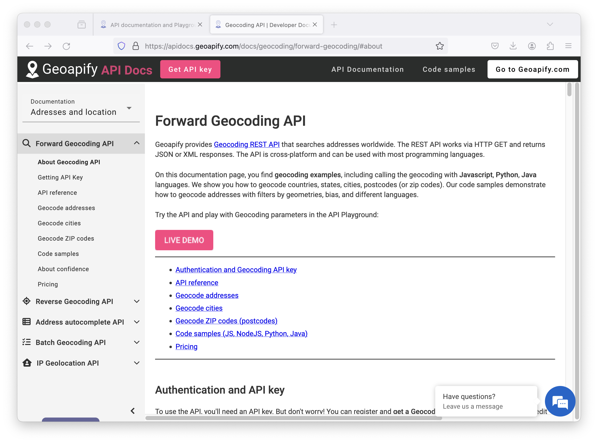

Slide 5
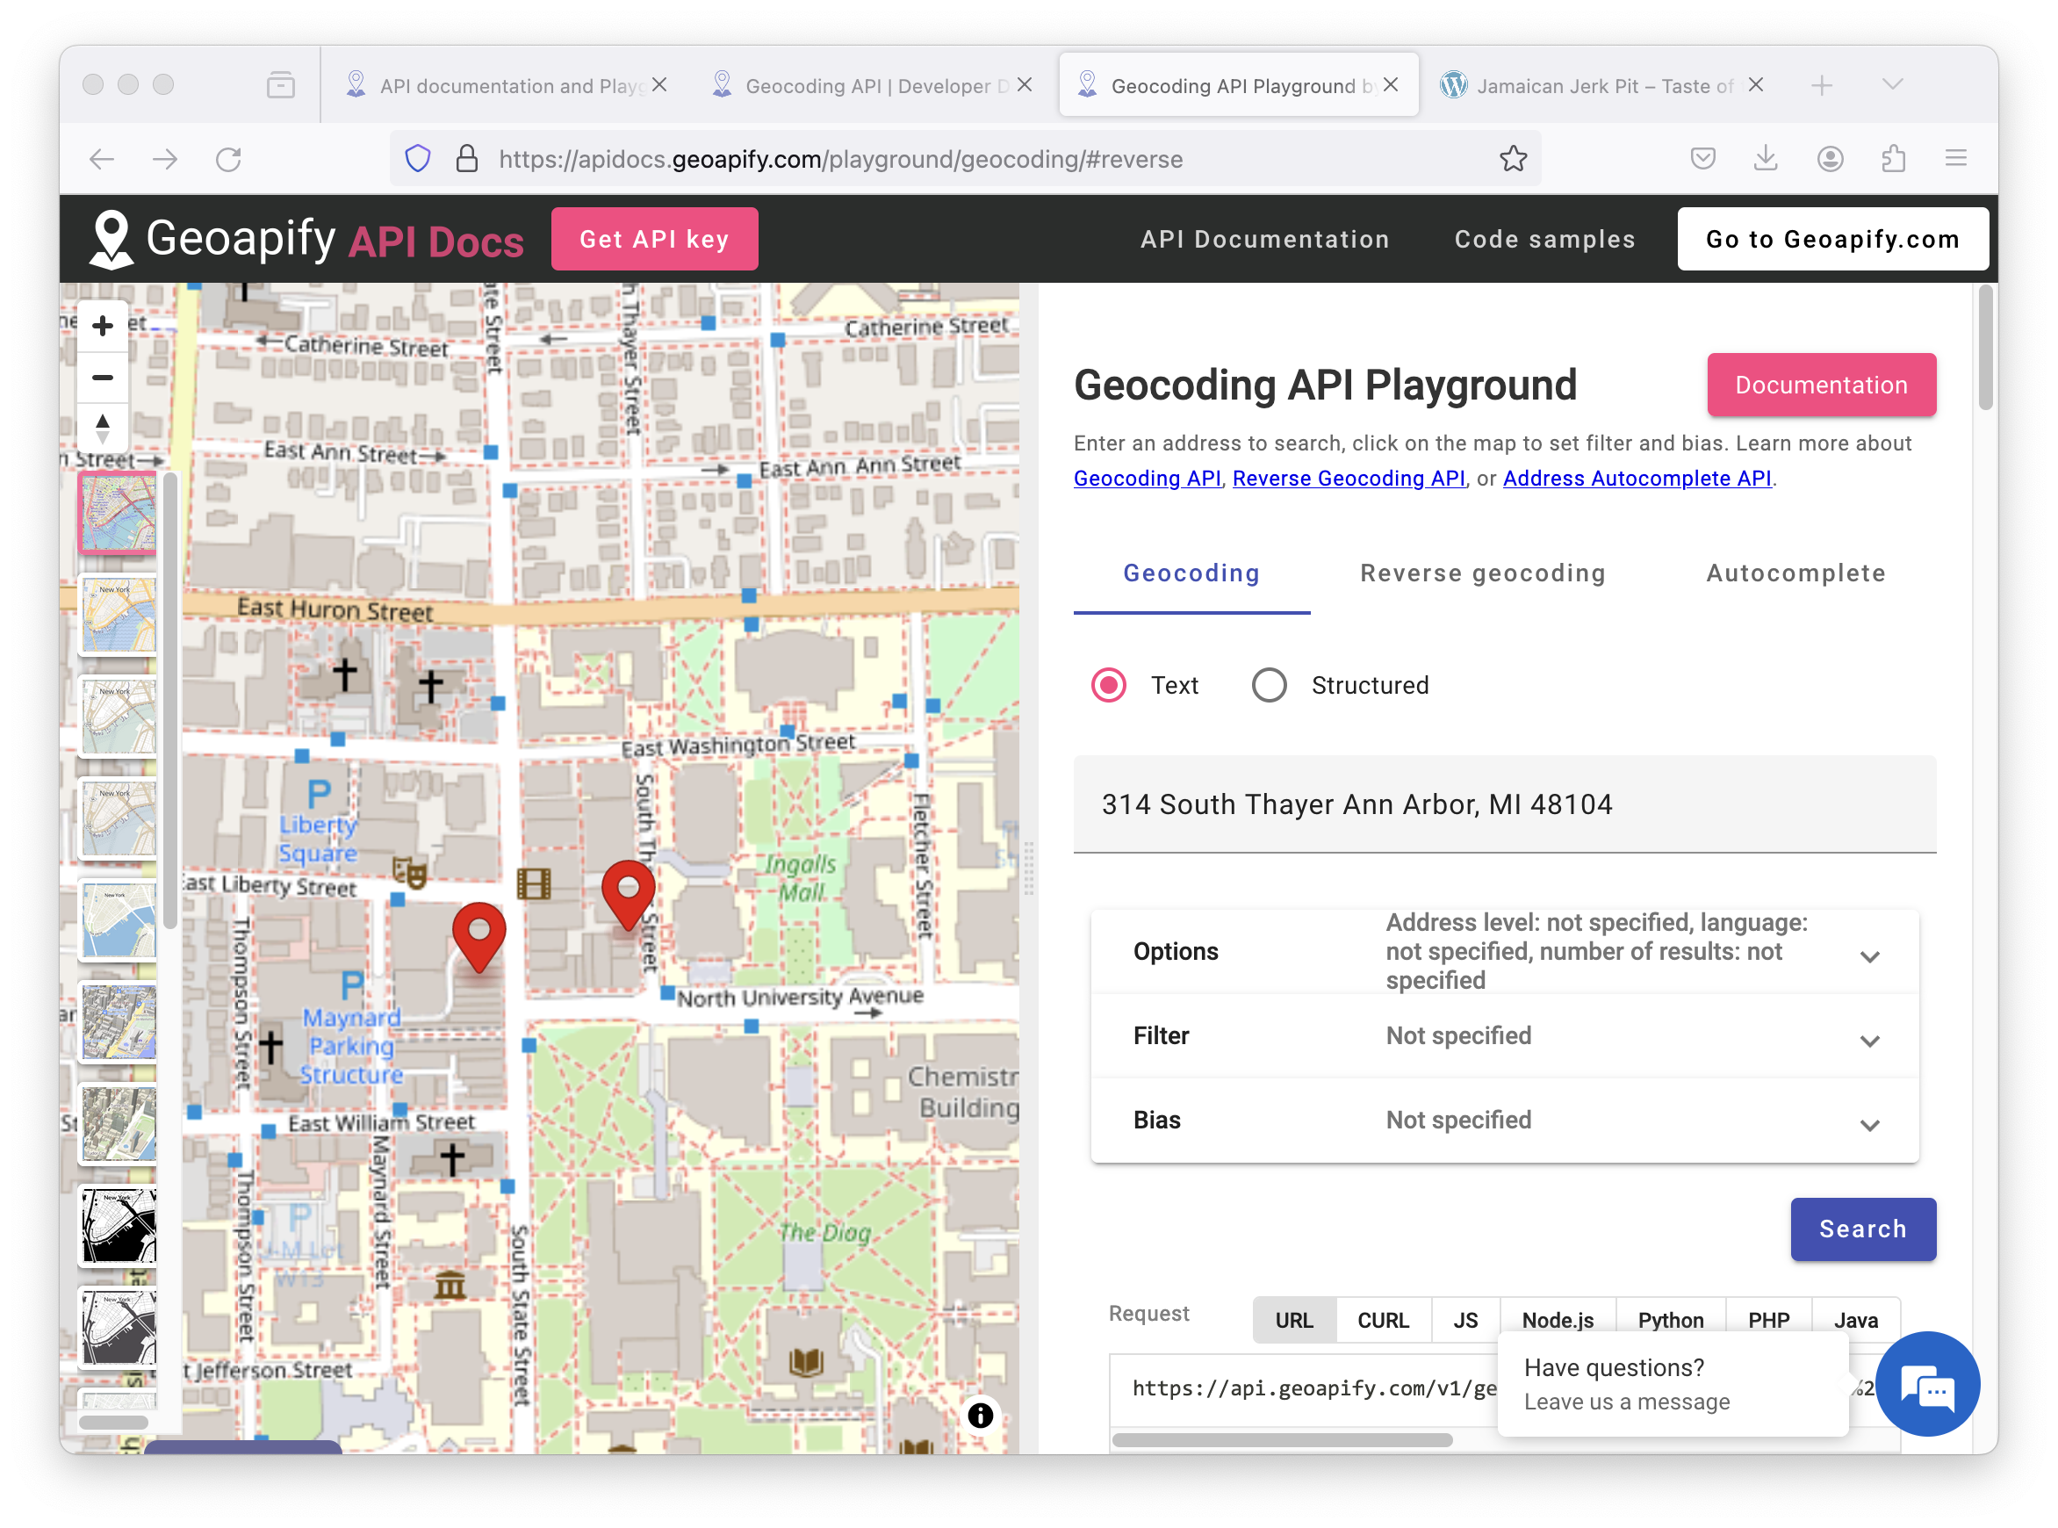

Slide 6
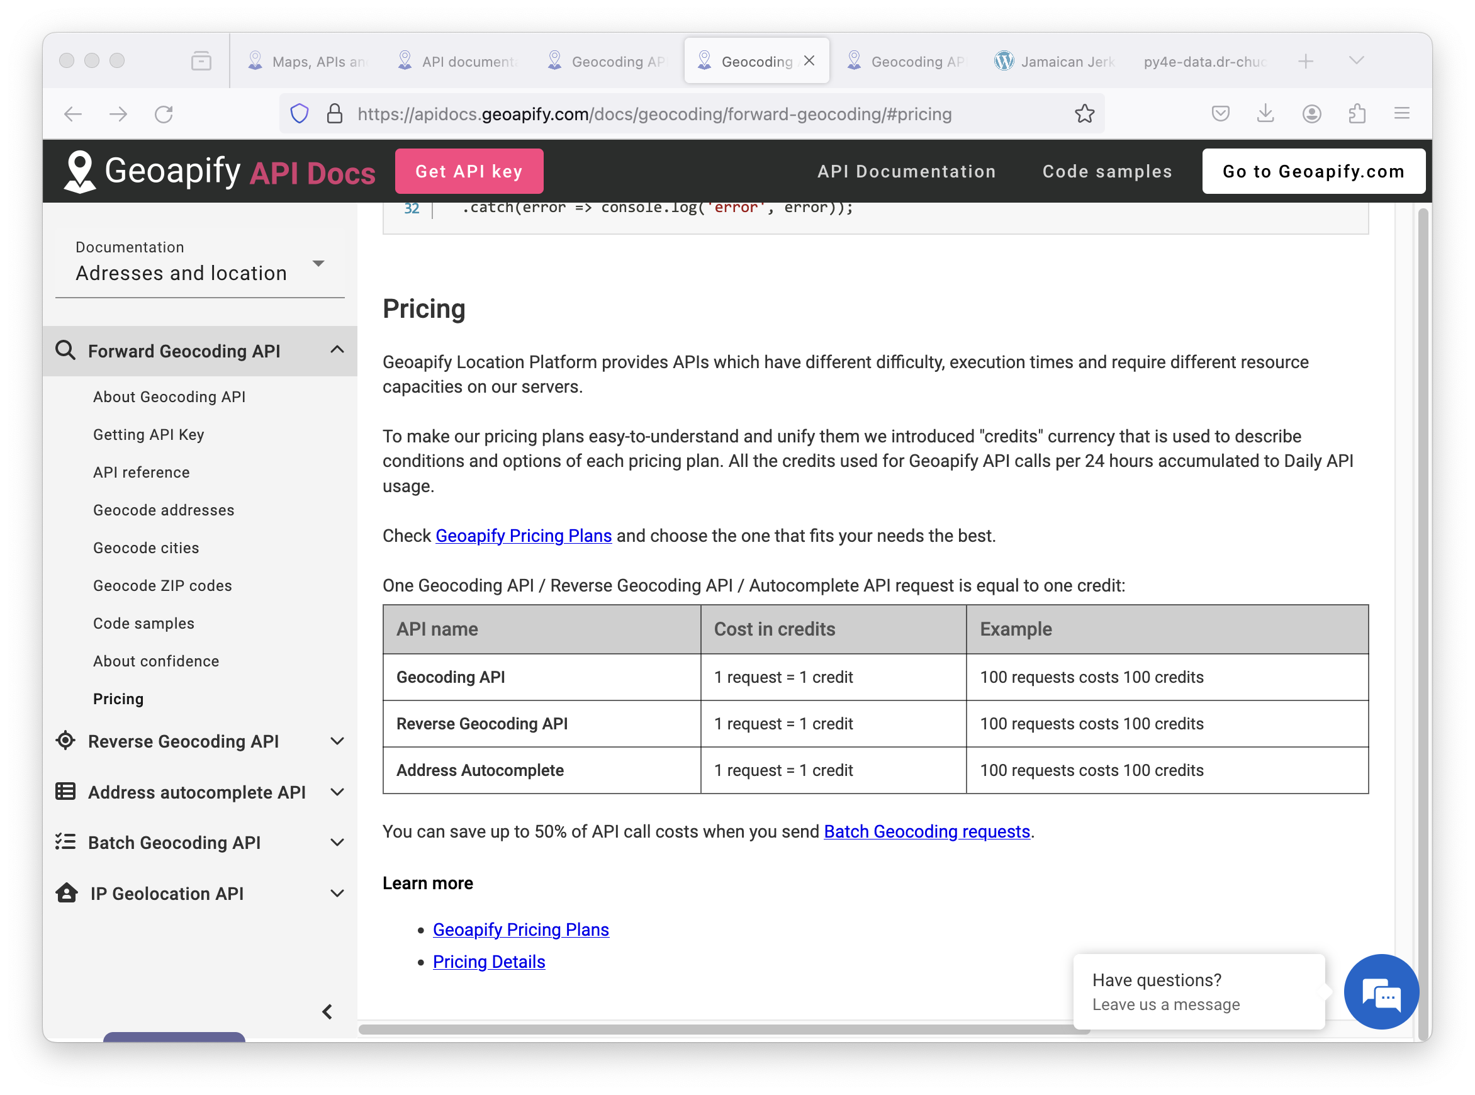

Slide 7
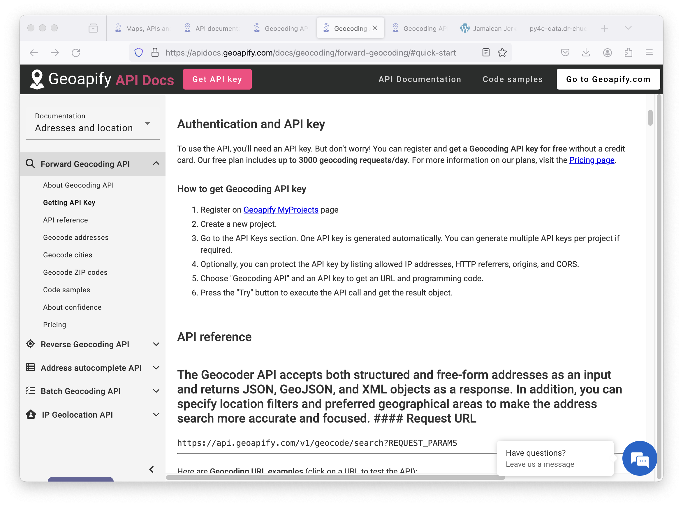

Slide 8
An API Proxy
To avoid making you get an account, I have a well-hidden web server that acts as a proxy for the Geoapify data
This proxy does not require a password – but it does have rate limits and is heavily cached using an edge-caching service for performance
Your code
cloudflare
py4e-data
Geoapi

Slide 9
{
"type": "FeatureCollection",
"features": [
{
"type": "Feature",
"properties": {
"datasource": {
"sourcename": "openstreetmap",
"attribution": "© OpenStreetMap contributors",
"license": "Open Database License",
"url": "https://www.openstreetmap.org/copyright"
},
"country": "United States",
"country_code": "us",
"state": "Michigan",
"county": "Washtenaw County",
"city": "Ann Arbor",
"lon": -83.7312291,
"lat": 42.2681569,
"state_code": "MI",
"result_type": "city",
"formatted": "Ann Arbor, MI, United States of America",
http://py4e-data.dr-chuck.net/opengeo?q=Ann+Arbor%2C+MI
Note, for this course, we operate through a proxy of the geoapi data to avoid rate limitation and authentication.
opengeo.py

Slide 10
import urllib.request, urllib.parse
import http, json, ssl
serviceurl = 'https://py4e-data.dr-chuck.net/opengeo?'
while True:
address = input('Enter location: ')
if len(address) < 1: break
address = address.strip()
parms = dict()
parms['q'] = address
url = serviceurl + urllib.parse.urlencode(parms)
print('Retrieving', url)
uh = urllib.request.urlopen(url, context=ctx)
data = uh.read().decode()
print('Retrieved', len(data), 'characters', data[:20].replace('\n', ' '))
js = json.loads(data)
lat = js['features'][0]['properties']['lat']
lon = js['features'][0]['properties']['lon']
print('lat', lat, 'lon', lon)
location = js['features'][0]['properties']['formatted']
Enter location: Ann Arbor, MI
Retrieving https://py4e-data.
dr-chuck.net/opengeo?q=Ann+Arbor%2C+MI
Retrieved 1319 characters {"type":"FeatureColl
lat 42.2681569 lon -83.7312291
Ann Arbor, MI, United States of America
opengeo.py

Slide 11
Summary
Service Oriented Architecture - allows an application to be broken into parts and distributed across a network
An Application Program Interface (API) is a contract for interaction
Web Services provide infrastructure for applications cooperating (an API) over a network - SOAP and REST are two styles of web services
XML and JSON are serialization formats

Slide 12


Acknowledgements / Contributions
These slides are Copyright 2010- Charles R. Severance (www.dr-chuck.com) of the University of Michigan School of Information and open.umich.edu and made available under a Creative Commons Attribution 4.0 License. Please maintain this last slide in all copies of the document to comply with the attribution requirements of the license. If you make a change, feel free to add your name and organization to the list of contributors on this page as you republish the materials.
Initial Development: Charles Severance, University of Michigan School of Information
… Insert new Contributors here
...

Slide 13
https://www.geoapify.com/

